Slide 1
Kinect-based virtual rehabilitation and evaluation system for upper limb disorders: A case study
W.L. Ding ^{a,∗}, Y.Z. Zheng ª, Y.P. Su^{b} and X.L. Li ^{c} ª Laboratory of Pattern Recognition and Intelligent Systems, Key Laboratory of Industrial Computer Control Engineering of Hebei Province, Department of Automation, Institute of Electrical Engineering, Yanshan University, Qinghuangdao, Hebei, China ^{b} Qinhuangdao First People’s Hospital, Qinhuangdao, Hebei, China ^{c} National Key Laboratory of Cognitive Neuroscience and Learning, Beijing Normal University, Beijing, China
《Journal of Back and Musculoskeletal Rehabilitation 》Q2

Slide 2
Introduction
Upper limb disorder (ULD) is “an umbrella term used to describe a variety of related injuries to the muscles, nerves, tendons and other soft body tissues of the finger, hand, wrist, arm, shoulder and spine”
80% of stroke survivors are affected by an upper extremity disorder
35% of all acute injuries seen in emergency rooms involve an upper extremity
90% of our daily life relies on the function of our upper limbs
ULDs seriously affect the health and the quality of life of affected patients and place a heavy burden on the patient’s family and society.
The rehabilitation of ULDs is thus an important issue in clinics.
Intense training involving active movements(peripheral limb manipulation and occupational therapy), in repetitive tasks and task-orientated activities can form an essential component of programmes that seek to modify neural organization and improve the recovery of functional movement skills
However, the rehabilitation costs are too high for many patients, and patients are also often not very active due to tedious training patterns.

Slide 3
Introduction
VR is an effective training tool that can provide real-time performance feedback, multimodal sensory information, a safe and entertaining training environment, and low-cost environments that can be duplicated.
Together, these features help patients increase the duration and intensity of rehabilitation
Many VR-based neural rehabilitation systems have been developed for upper-limb dysfunction since the late 1990s
Wired: data glove, motion-capture devices, a robot, or haptic devices (expensive/inconvenient/uncomfortable)
Wireless: Wii, web camera or industry camera, Kinect sensor
Recently, the Kinect sensor has been used as a low-cost alternative for real-time motion capture and body tracking, and this device has significant potential for rehabilitation.
Full-body human 3D motion capture, video facial recognition and voice recognition
Kinect software development kit (SDK)
However, key problems, including personalized interaction, serious game development, reasonable training and evaluation methods for patients with different types of disorders, still require further research.
In this study, a Kinect-based virtual rehabilitation and evaluation system (Kine-VRES) was developed to increase the coordination, control, and speed in the use of the shoulder.
Reaching and grasping movements
Two ataxic patients who underwent three weeks of training using the Kine-VRES system.

Slide 4
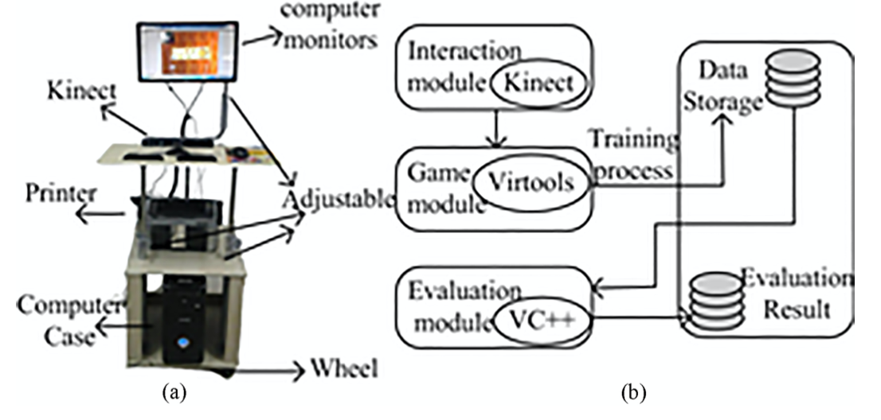
Design of the neural rehabilitation system
The hardware:
personal computer (PC): for all computational processing
19-in liquid crystal display (LCD): for the audio and visual feedback streams
Microsoft Kinect sensor: simultaneously record the video, depth map, and skeleton data of the patient
Printer: output an evaluation report that includes a velocity profile and the jerk-based measures of movement smoothness
Mobile table: be easily adjusted for the correct fit whether the training occurs when the patient is standing, sitting or lying down

Slide 5
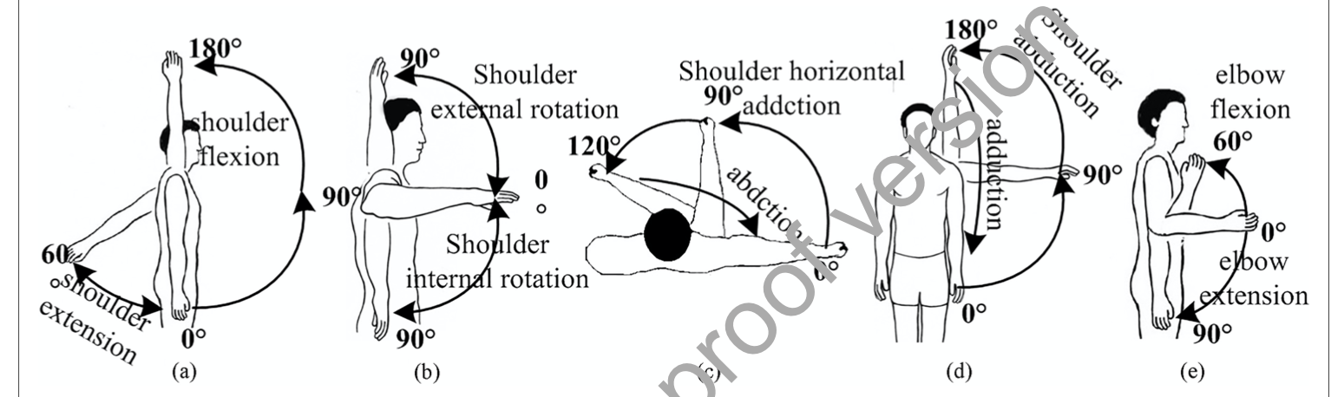
Design of the neural rehabilitation system
The software architecture:
Virtools 5.0
The interaction module: provides several interactive modes and a customized method of assisting the patient in making decisions related to the interactive mode
The game module: contains a series of virtual tasks that correspond to the specific interaction mode
The evaluation module: the therapist or patient can evaluate the effectiveness of the rehabilitation
A database

Slide 6

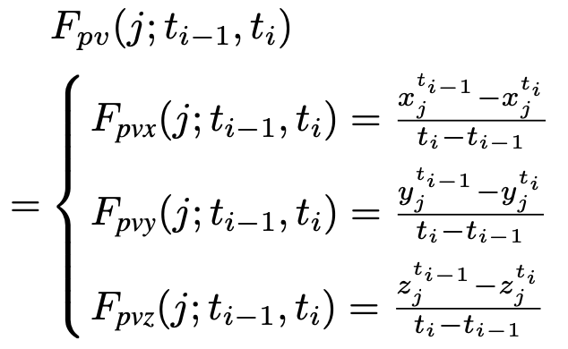
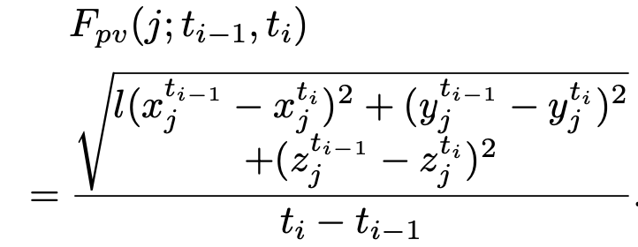
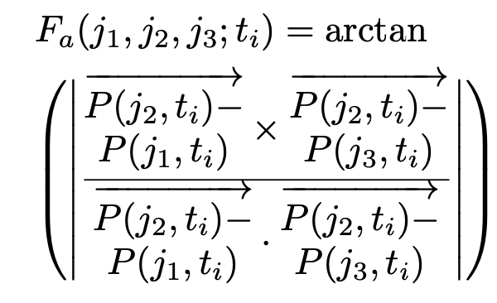

Interaction with virtual environment
3D position of a joint$j$at the current time $t_{i}$:
Three velocity components of a joint $j$ at the current time $t_{i}$:
The velocity of a joint $j$ at the current time $t_{i}$:
The joint angle between three joints $j_{1}$, $j_{2}$, $j_{3}$ at the current time $t_{i}$:

Slide 7
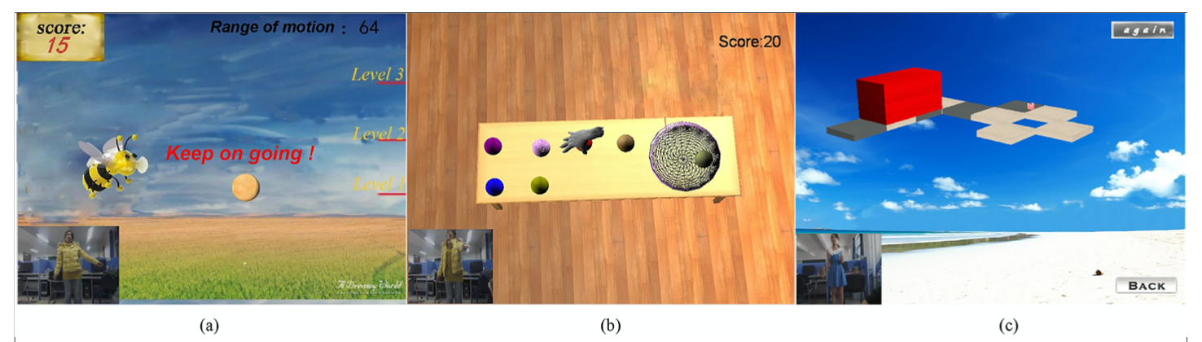
Interaction with virtual environment
Interacts with the virtual environment in two ways
The kinematic parameters are directly mapped to the motion parameters of the virtual object.
The kinematic parameters are used to first identify the upper limb movements defined in our system, and the identified movements are then used to trigger the virtual object motion.
The virtual tasks and feedback
According to the suggestions of therapists and the main principles of training, the rehabilitation games should have the ability to increase the duration, frequency and muscle strength of treatment and create the appropriate, personalized practice paradigm.
The feedback is added into the designed games, and the different difficulty levels, varying from simple to complex, are available.

Slide 8
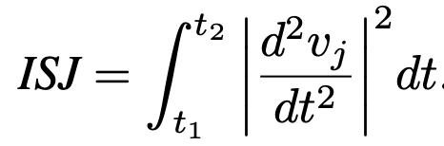
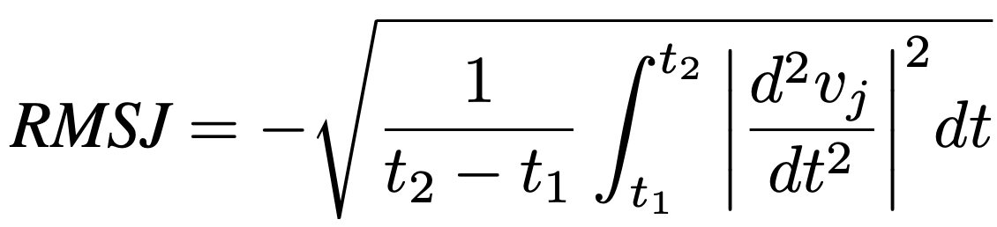
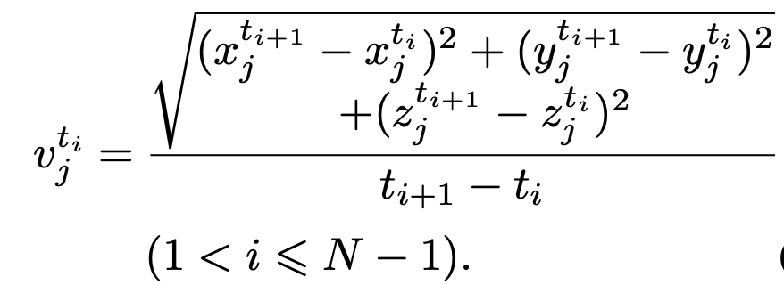
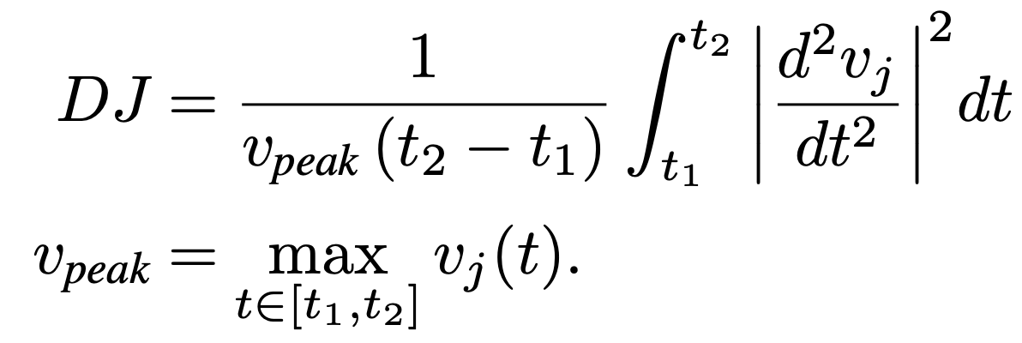
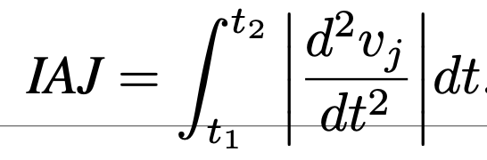
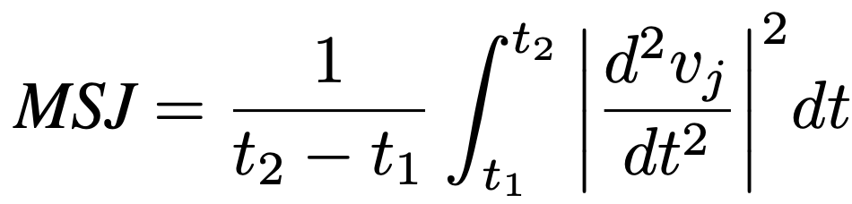
Assessment of the movement
Two types of functions are provided in the evaluation module of the Kine-VRES system. These functions are a quantitative evaluation and a short questionnaire.
The quantitative evaluation indexes of the rehabilitation of patients with ataxia are estimated based on the following jerks in the proposed system.
Integrated squared jerk (ISJ)
Integrated absolute jerk (IAJ)
Mean squared jerk (MSJ)
Root mean square jerk (RMSJ)
Mean squared jerk normalized by peak speed(MSJP)
The short questionnaire includes seven items.
feeling of enjoyment
Evaluation of whether the difficulty of the virtual task is suitable
Success
Control
feeling of interaction
Evaluation of whether playing the game is effective rehabilitation
Sense of being in the environment.

Slide 9
A case study
In the rehabilitation center of the Qinhuangdao First People’s Hospital.
Participants
two male subjects with ataxia caused by stroke
Patient A: 48 years old
Patient B: 57 years old
Both participants presented with an inability to smoothly reach a target and both had lost the coordination of their upper limbs for over a year.
Training procedure
Patient A: shoulder flexion and shoulder horizontal abduction movement with his left shoulder(G 1, 2)
Patient B: elbow flexion/extension and shoulder internal/external rotation movement with his right arm. (G 3)
1 hour/ day, 5 days/week, 3 weeks.
A therapist was asked to give some instructions at the beginning and end of this training program.
The participants were asked to complete finger-to-finger movement tasks at the beginning of the rehabilitation session, and the 3D coordinates of the wrist were simultaneously recorded.
The participants performed the rehabilitation training using the selected virtual tasks and interact mode.
On the last day, the patients were asked to perform the finger-to-finger tests again to record the 3D coordinates of the wrist.
During the training period, the exercise database was filled, and the smoothness measures of the movements during the finger-to-finger tests were calculated to evaluate the effects of the rehabilitation.

Slide 10
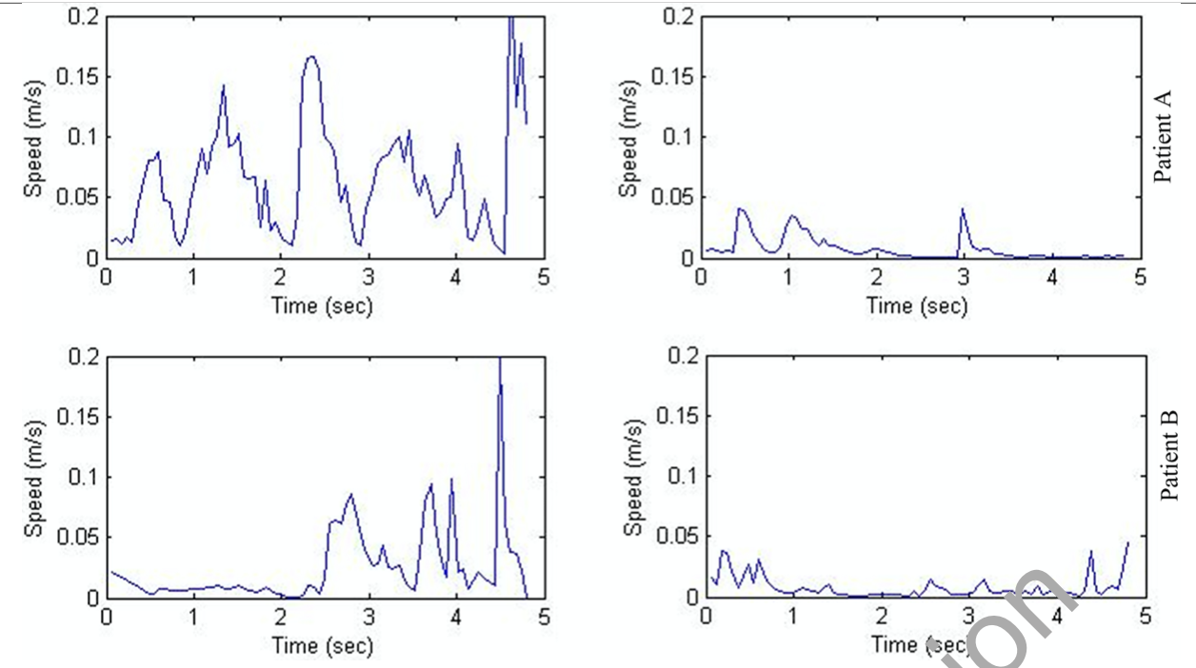
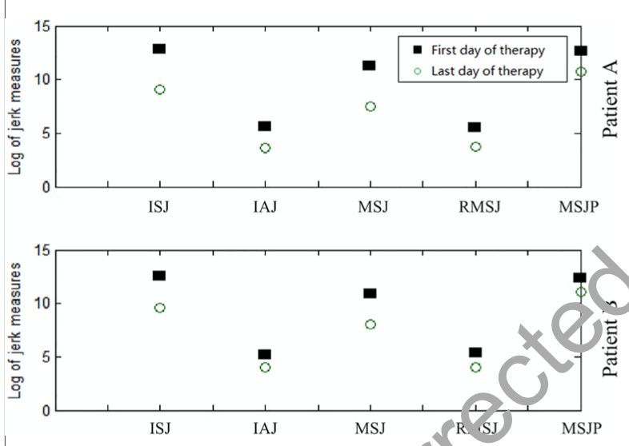
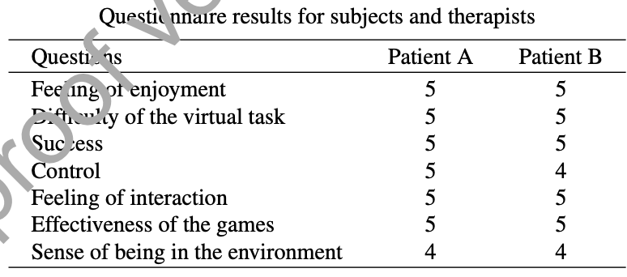
Results
Quantitative evaluation result
Short questionnaire about the system

Slide 11
Discussion
The main aim of this study was to investigate the feasibility of the Kine-VRES system to improve the use of an upper limb to complete goal-oriented movements.
The quantitative evaluation result demonstrated that the training tasks designed in the system were able to enhance the coordinate capacities and motor performances of two patients with ataxia.
In addition to the measured quantitative outcomes, the participant feedback provided by the short questionnaire also indicated whether the selected interaction mode and virtual tasks were appropriate for two patients.
Another finding was that the difficulty level of the virtual task had some influence on the training effect and quality
It is very important to determine whether the virtual task and interaction mode are appropriate for each specific patient during each rehabilitation section.
Compared with other studies that have been based on the use of the Kinect for rehabilitation, the advantage of our system is that it proposes quantitative evaluation results, and it can help patients quickly perform self-assessments.
Limits:
First, richer virtual tasks should be developed to meet the needs and interests of different patients.
Second, additional research with different individuals is still needed to demonstrate the efficacy of the developed system.
The current version of the system only focused on the wrist, elbow, and shoulder; future studies should integrate these foci with hand training, and more subjects should be selected to participate in the experiments.

